Slide 1


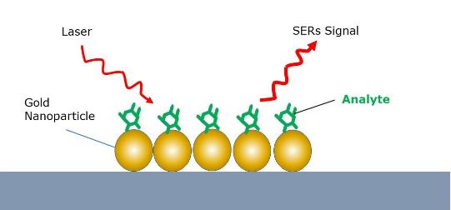
Unique naked nanoparticle SERS substrates
V. J. Broadley, A. H. Kean, S. R. Saranu, D. C. Mason
Problem: Surface Enhanced Raman promises trace detection of analytes at ppb and ppm levels. Liquid SERS offers high sensitivity but requires complex handling and different workflow for each analyte. Solid SERS substrates are often expensive and unreliable. Neither is ideally suited for field use.
Aim : Develop SERS substrate with high Sensitivity, high Specificity, high Reproducibility which is suitable for field use.
Our Approach: Solid SERS substrate that utilizes ligand free, bare gold nanoparticles deposited in vacuum.
Introduction
Method
SERS substrates are prepared under vacuum in the Nikalyte NL50 using a physical technique called Inert gas condensation using 99.99% purity source material. As no chemicals are involved in the technique the nanoparticles generated are naked, ultra-pure and ligand free.
Gold atoms generated by plasma
Gold (Au) source material
Gold Nanoparticle generation region
Nanoparticle deposition chamber
SERS substrate

Slide 2
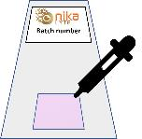
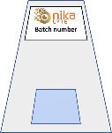
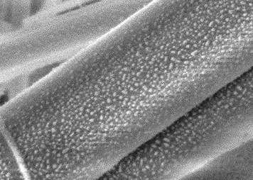
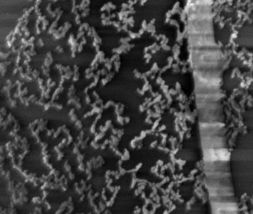
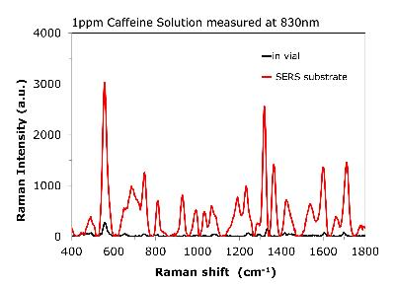
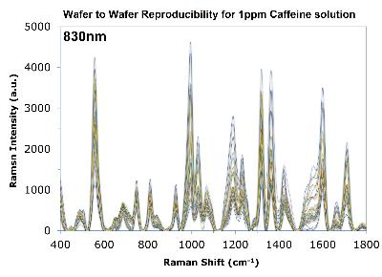
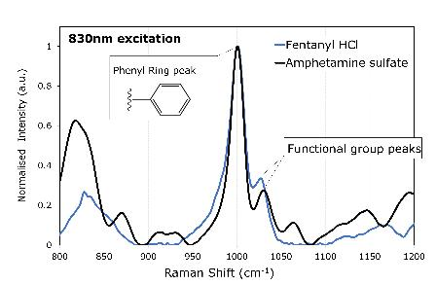
Corresponding author vicky.broadley@nikalyte.com
Visit us at www.nikalyte.com or follow us at @NikaLyte_nano
Results
Liquid SERS effect
As prepared SERS substrate are pink with uniform and monodisperse coverage of gold (Au) nanoparticles.
On Application of analyte Au nanoparticles self-organize around analyte molecules to form long chain agglomerates, signified by change to blue colour => Enhanced Raman Signal measured for Caffeine, Ibuprofen, Fentanyl, MDMA, Melamine, Heroin, Amphetamine, Heroin and more….
Self organization around analyte molecules yields 1000x increase in Raman signal – high sensitivity
Naked nanoparticles ensures low background signal - high Specificity
Self-organization around analyte molecules ensures high performance from substrate to substrate - high Repeatability
Simple handling of analyte dissolved in DI water and results in minutes – suitable for Field Use
Conclusions
SERS substrates using naked Au nanoparticles ideal for field use
High reliability and specificity ideal for trace detection for narcotics, food safety, forensics and more…
High Sensitivity
High reproducibility
High Specificity

