Slide 1

Application of soft landed nanoparticles generated using the terminated gas condensation (TGC) technique to Surface Enhanced Raman
V. J. Broadley, A.H. Kean, S. R. Saranu, D. C. Mason

Slide 2
Outline of Presentation
Surface enhanced Raman effect
Current approaches to SERS – chemical vs physical
Nikalyte’s compact & simplified TGC deposition system
Performance on TGC-generated SERS substrates
How do they work?
Conclusions and Further Work

Slide 3
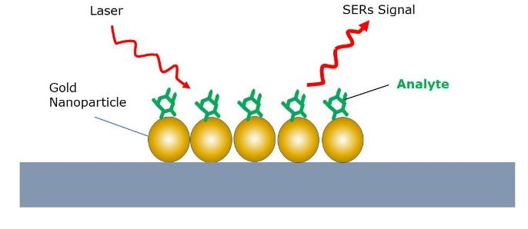
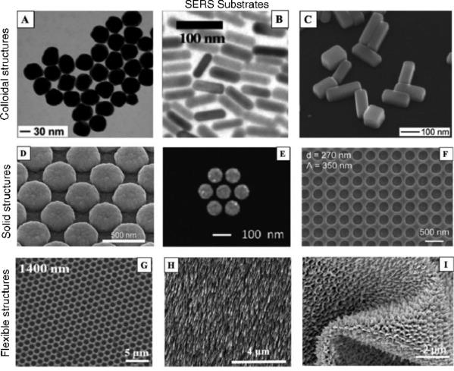
Approaches to Surface Enhanced Raman Spectroscopy
SERS exploits surface plasmon resonance & electric field enhancement at Nobel metal surface.
High radius of curvature = > highest Raman enhancement
= > nanostructures & nanoparticles
Different approaches to SERS
  Prepared with Chemistry
    Colloidal nanoparticle SERS solution
    Chemical SERS substrate
  Prepared with Physical techniques
    Micropatterned substrate
    Electrodeposited substrate
    Magnetron sputtering/GLAD
    Terminated gas condensation
Fundamentals and applications of SERS-based bioanalytical sensing M. Kahraman et al Nanophotonics 2017 (6) 0174

Slide 4
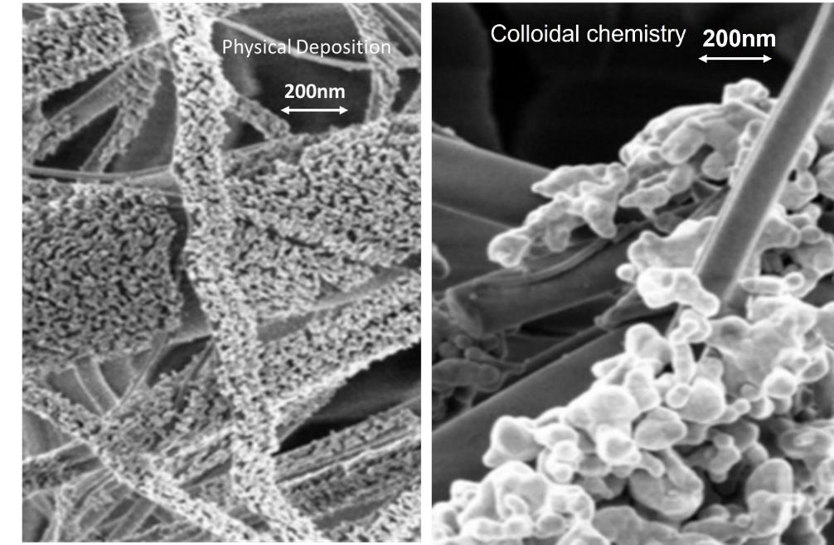
Chemical vs PVD
Chemical /colloidal SERS synthesis
Difficult to control synthesis
Non-uniform size and coverage
Clumping
Chemical contamination
=> Unreliable SERS measurement, low SERS signal to noise, poor measurement repeatability
Physical SERS synthesis
Ultra pure and contaminant-free
Uniform coverage / uniform structure
Non-clumping
Repeatable process
Potential for => improved reliability, improved repeatability, high SERS signal to noise

Slide 5
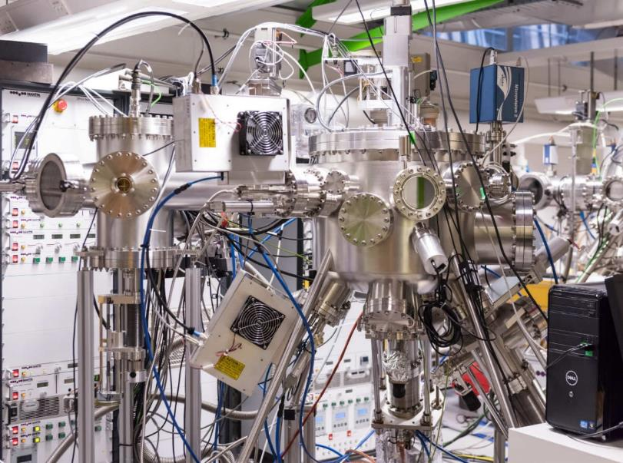
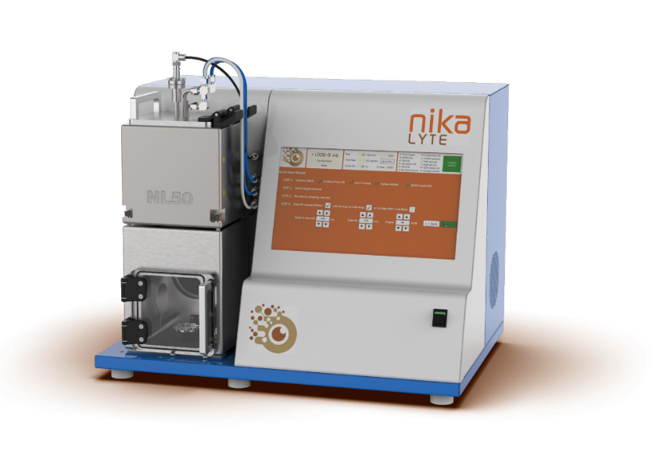
NL50 – compact TGC system
Aggregation zone
Fixed aggregation length
dc power supply
Optimized for gas flow and differential pumping
Flip top lid
1-inch magnetron
quick target loading and exchange
Touch screen
PLC control of
Process Recipes
Vaccuum operation
Imperial College - PVD system with TGC source
Small chamber volume
Quick pump down and faster turnaround
Single turbo pump
HV chamber with 1E-6 mbar base pressure

Slide 6
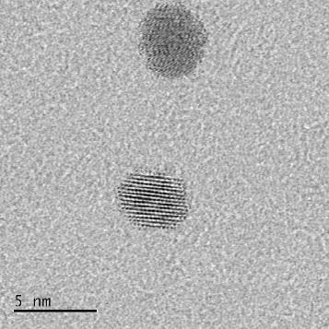
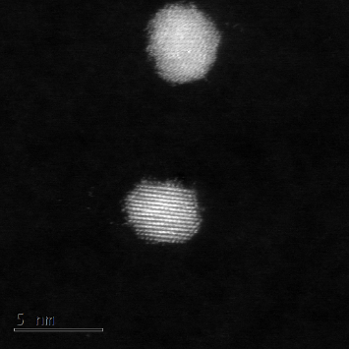
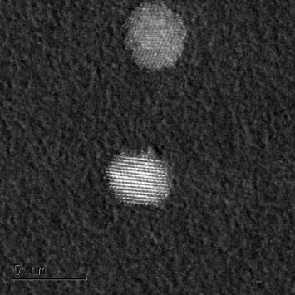
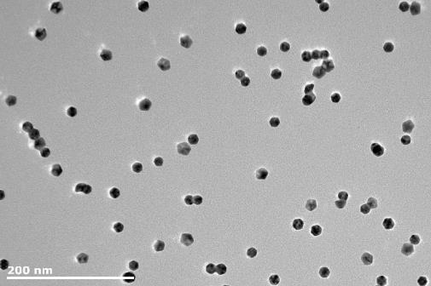
Nanoparticles generated in NL50
HRTEM images of Pt nanoparticles
Au
BF
HAADF
BSE
Ag
The bright-field (BF) images shows crystalline structure
The bright HADDF image show high density of Pt.
Backscattered electron (BSE) image shows crystalline surface of NP, indicating surface is clean and free of contamination, i.e. sulphur.
Nanoparticles are crystalline, monodisperse and contamination free

Slide 7
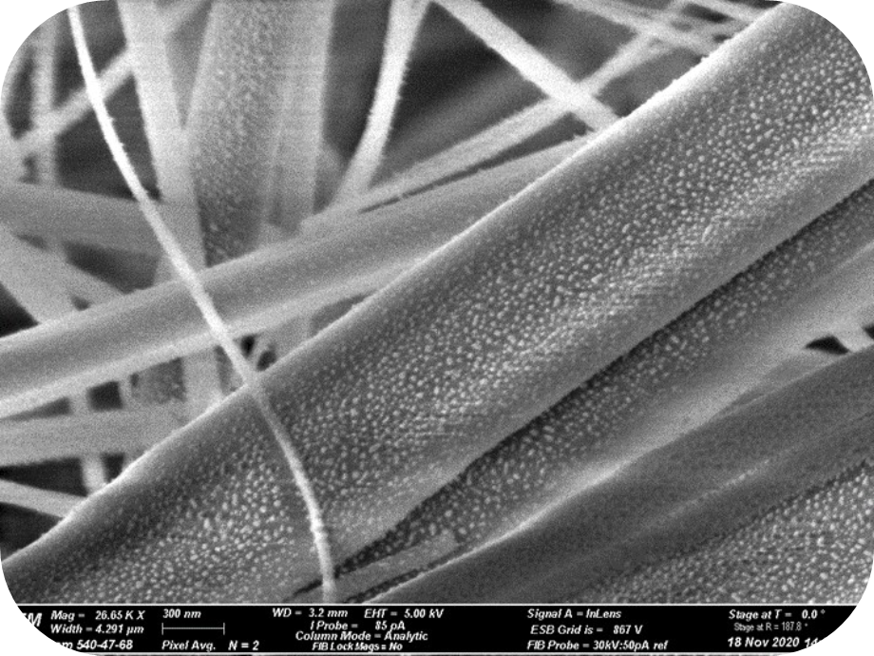
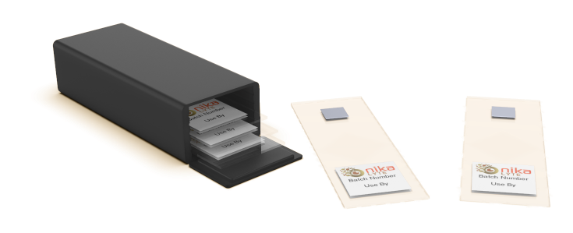
TGC nanoparticle SERS substrate
Gold nanoparticles deposited in NL50
Size range ~15-20nm
Non-clumping and monodisperse.
Soft landed onto glass filter paper
No acceleration or mass filtering
Filter paper diced and mounted on glass slide
300nm

Slide 8
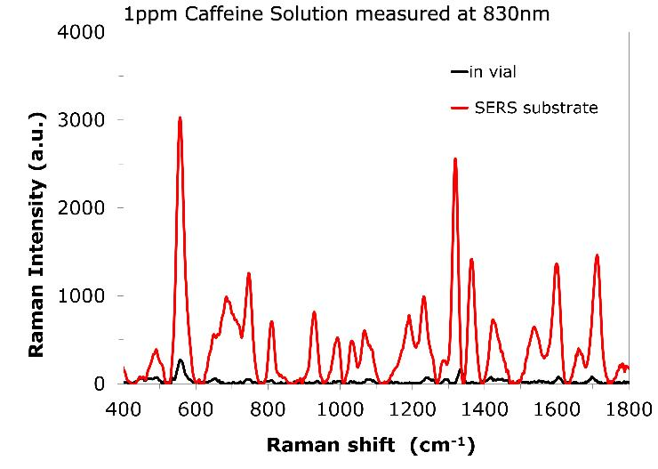
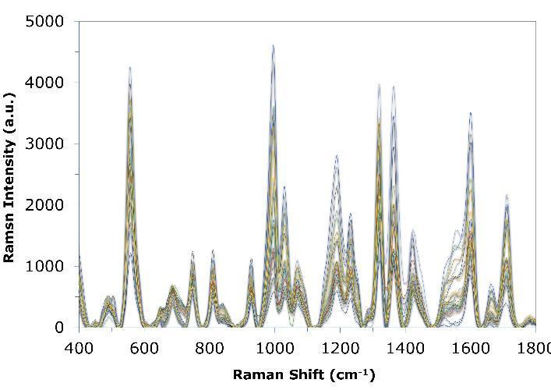
SERS measurements
Wafer-to-wafer repeatability for 1ppm Caffeine at 830nm
300nm
200nm
High sensitivity
Huge enhancement in Raman signal of at least x1000 compared to in-vial measurement
High Signal to Noise
enables trace element detection (ppm/ppb levels)
=>attributed to ultra-pure, contaminant-free nanoparticles.
High reliability
Excellent repeatability for different sensors
=>attributed to uniform coverage of nanoparticles without clumping

Slide 9
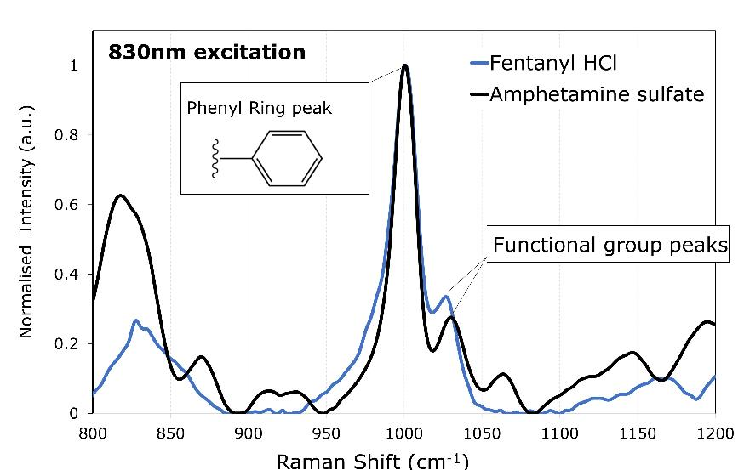
SERS applications
785nm
300nm
Narcotics
High signal to noise enables discrimination of similar molecules from secondary peaks.
Low-intensity Raman peaks often hidden by the background
Food Safety
High sensitivity enables detection of low conc analytes
Customers report Limit of detection often lower than other commercial substrates

Slide 10
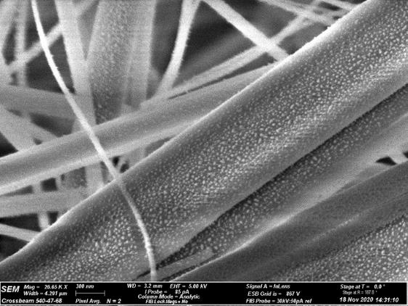
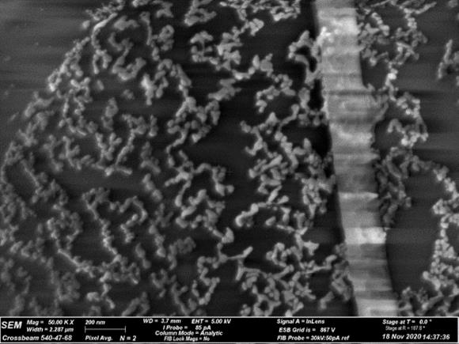
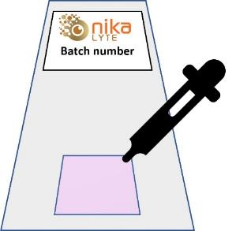
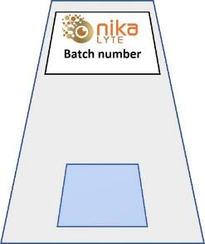
Liquid SERS effect
As Deposited
After application of analyte
300nm
200nm
Soft landed nanoparticles are not strongly adherent to substrate
Nanoparticles self-organize on application of liquid analyte
Self-organization of nanoparticles key to the performance of sensors
  traps analyte molecules to maximize contact
  enhancement occurs for wide range of molecules
  High number of hot spots on Long chains to maximize SERS effect

Slide 11


Conclusions and further work
Demonstrated crystalline and contaminant-free nanoparticles from simplified TGC system (NL50)
Demonstrated high-performance SERS substrates produced by gas phase synthesis
Low noise level and enhanced detection at low concentrations due to high mobility and purity of nanoparticles
What’s next?
Explore new nanoparticle structures (alloy/core-shell) and materials (silver) for SERS
Develop SERS sensors for specific applications
Large target market is biosensors - focus on point of care detection/monitoring
300nm
With thanks to our partners

